Slide 1
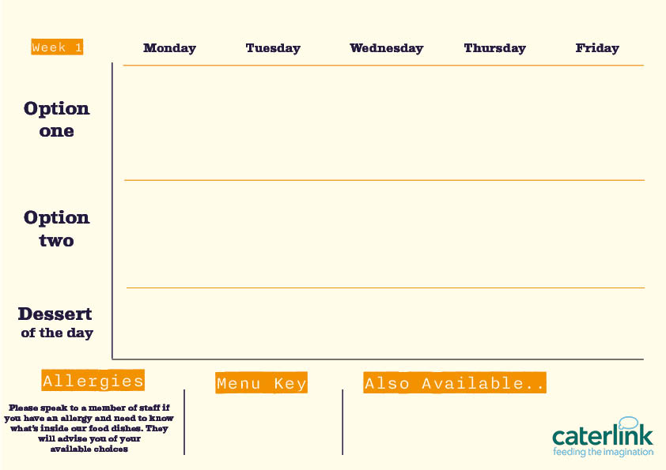






Spring Summer Menu 2026
Smokey Beef Chilli Tacos and Wedges
with Fresh Tomato, Pineapple and Cucumber Salsas
Roast Chicken with all the Trimmings
with Roast Potatoes, Stuffing, Carrots, Broccoli and Gravy
Fishfinger Sandwich
with Chips, Peas and Tartare Sauce
Chicken Shawarma
with Tabouleh, Tomato Salad, Pickles and Dips
Chicken
Biryani
with Sambals
Butternut & Feta Quesadilla and Wedges
with Fresh Tomato, Pineapple and Cucumber Salsas
Quorn Roast with all the Trimmings
with Roast Potatoes, Stuffing, Seasonal Veg and Gravy
Delhi Hound Dog
with Mango Chutney, Served with Chips
Falafel Bowl
with Tabouleh, Tomato Salad, Pickles and Dips
Vegetable Biryani
with Sambals
Sticky Toffee Apple Crumble
with Custard
Pineapple Upside Down Cake
Chocolate Brownie
Jam & Coconut Sponge
Oaty Flapjack
Vegan option
Our hot and cold grab & go selection alongside soup of the day and filled jacket potatoes
Added plant protein
Source of wholemeal

Slide 2


Spring Summer Menu 2026
Battered Fish or Salmon Fishcake
and Chips with Garden Peas
BBQ Pulled Pork Slider
with Paprika Wedges and Slaw
Mac and Cheese with Toppings
Croutons, Pepperoni Pieces, Crispy Onions, Spring Onions, Barbecue Beans
Chicken Tikka Masala
with 50/50
Rice and
Sambals
Original Spice Chicken
with Spicy Rice and Rainbow Slaw
Summer Broccoli and Feta Quiche
with Summer Salad and Chips
Burrito Bowl
with Rice, Charred Corn Salad, Salsa and
Sour Cream
Sweet Potato, Chickpea & Spinach Tikka
with 50/50 Rice
and Sambals
Smokey Bean
Burger
with Spicy Rice and Rainbow Slaw
Chocolate Orange Cookie
Cherry Apple Crumble
with Custard
Peach Upside Down Cake
with Custard
Fruit
Muffins
Chocolate Swirl
Vegan option
Our hot and cold grab & go selection alongside soup of the day and filled jacket potatoes
Added plant protein
Source of wholemeal

Slide 3



Spring Summer Menu 2026
Classic Beef Lasagne
with Garlic Bread and Chunky Roasted Summer Veg
Chip Shop Fish or Sausage
with Chips, Mushy Peas and Gravy or Curry Sauce
Gochujang Sticky Chicken
with Rice and Cucumber Shaker Salad
Chicken Souvlaki
with Seasoned Potatoes, Tzatziki and Greek Salad
Jerk Chicken Thighs
with Rice & Peas, Broccoli and Spiced Pineapple Slaw
Yakisoba Soya
Noodles
Stir Fry with Edamame Beans
Tuscan Chickpea Pasta
with Garlic Bread
and Chunky Roasted Summer Veg
Chip Shop Vegan Sausage
with Chips, Mushy Peas and Gravy or Curry Sauce
Curried Squash & Butterbeans
with Rice & Peas, Broccoli and
Pineapple Slaw
Spanakopita
With Seasoned Potatoes, Tzatziki and Greek Salad
Sticky Toffee Apple Crumble
with Custard
Chocolate Crunch Cake
Eton Mess
Apple Pie
with Custard
Iced Sponge Cake
Vegan option
Our hot and cold grab & go selection alongside soup of the day and filled jacket potatoes
Added plant protein
Source of wholemeal

