Slide 1

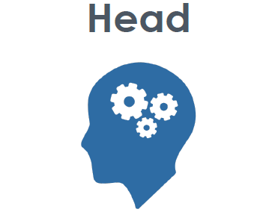


Critical Thinking
Knowledge
Understanding
Problem Solving
Analysis
Feedback
Teamwork & Leadership
Communication
Leadership
Respect
Resilience
Confidence
Motor Competence
Physical Ability
Fitness Development
Competitive
Technique
Tactics
Healthy Active Lifestyles

